Slide 1
QUT Uninhabited Aerial Systems
Objective: to develop a fully cooperative UAS with onboard sense-and act capabilities.

Slide 2
QUT UAS Team
Luis Mejias
Science leader
Supervising Controller
Scott McNamara
UAV/payload controller
Rhys Mudford
Supervising/payload controller
Richard Glassock
Launch Controller
Brenden Menkens
Engineer
Nicholas Rutherford
Engineer
Task:
Advanced Flight Termination System for UAS
Task:
Predictive Flight Management System for UAS

Slide 3
Predictive Flight Management System Nicholas Rutherford

Slide 4
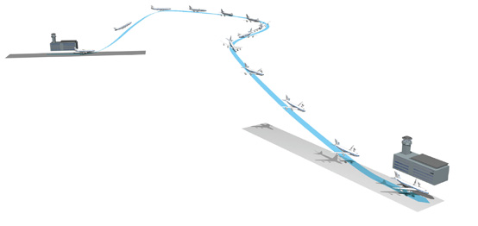
Presentation Contents
Predictive Flight Management System Concept (PFMS)
Systems Engineering Practices
High Level Objectives
Work Breakdown
Schedule
Project Risks and Budget
PFMS Models
Three Degree of Freedom Model
Six Degree of Freedom Model
Model Comparison and Validation
Project Future and Final Key Notes
Conclusion

Slide 5
PFMS Concept
Concept
Determines when and whether the UAS will intercept a waypoint in a defined time.
Identifies invalid waypoints sent by the traffic controller due to communication latency.
Current QUT systems
Use displacement and velocity to predict arrival times.
Ignore the dynamics of the aircraft, weather effects and the effect of successive waypoints on flight trajectory.

Slide 6
PFMS Concept

Slide 7
Project High Level Objectives
HLO-1 - Mandatory
Conduct a literature review on FMS, control and aircraft dynamics
HLO-2 - Mandatory
Develop a 2D & 3D PFMS simulation
HLO-3 - Desired
Install and validate the PFMS capability onboard a UAV
HLO-4 - Desired
Design an advanced PFMS capability and install and validate on a UAV

Slide 8

Work Breakdown Structure

Slide 9
Project Schedule

Slide 10
Project Budget & Risks
Project Budget
No incurred costs for software development.
Future Costs will be covered by the QUAS project.
Project Risks
Risk Management Plan.
Single Working Engineer.
Possible complex control methods and high level of coding proficiency.

Slide 11
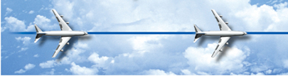
PFMS Models
Three Degree of Freedom Model
Matlab used for implementation.
Lacking multiple waypoint considerations.
2D prediction model with Rate of Turn Constraints at cruise velocity.
3D prediction model with Rate of Turn and Climb constraints at cruise velocity.

Slide 12
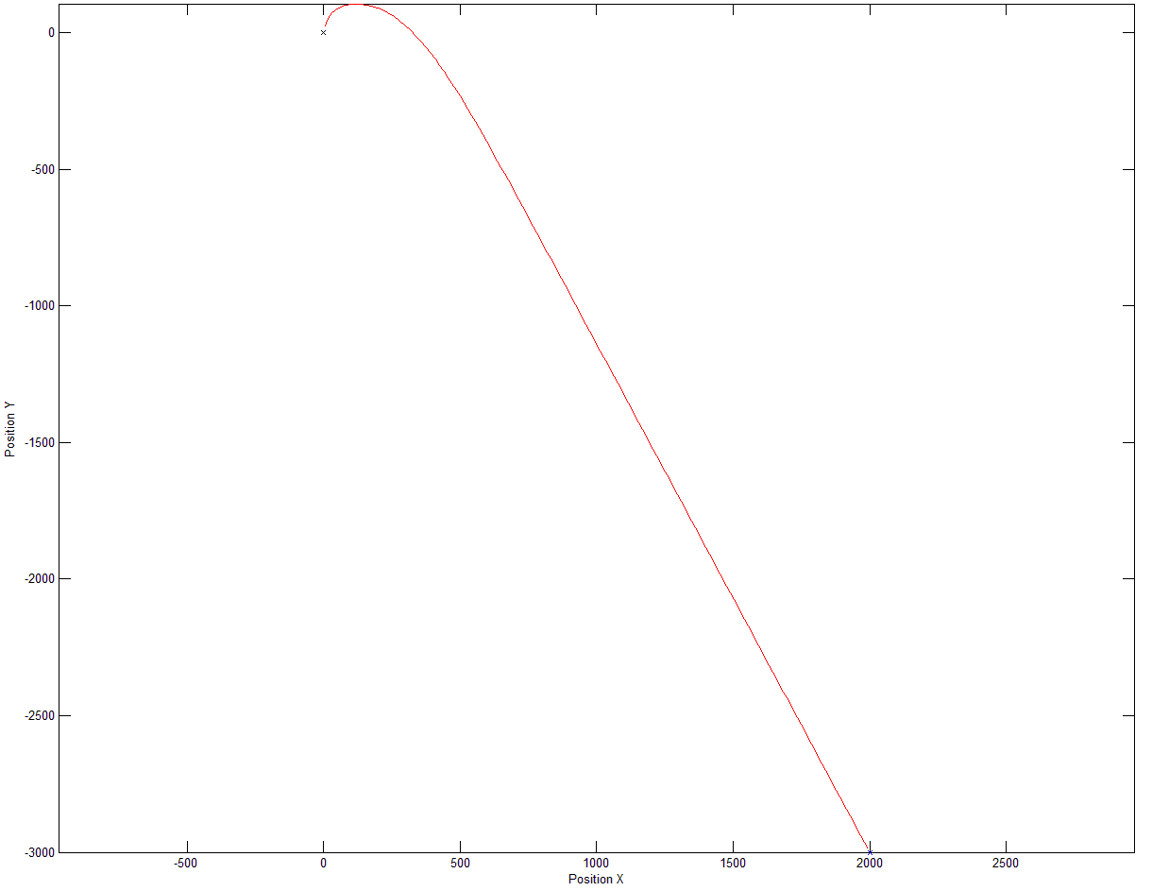
2D Trajectory

Slide 13
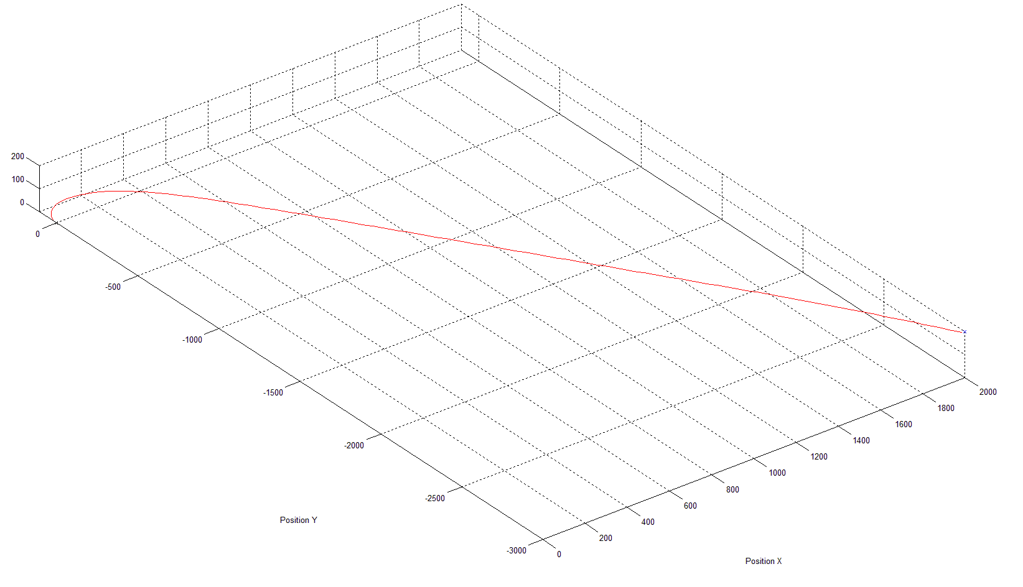
3D Trajectory

Slide 14
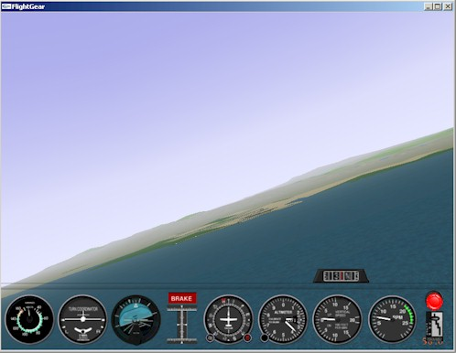
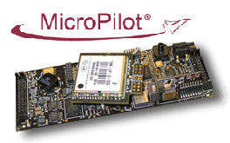
Six Degree of Freedom Model
Based around a MicroPilot Autopilot
Matlab Simulink and Aerosim Blockset
Capable of prediction of a UAS in with waypoint navigation and attitude considerations
Model visualisation using Flight Gear
Aerosim uses JBSim, a open source C++ model.
FlightGear Flight Simulation

Slide 15
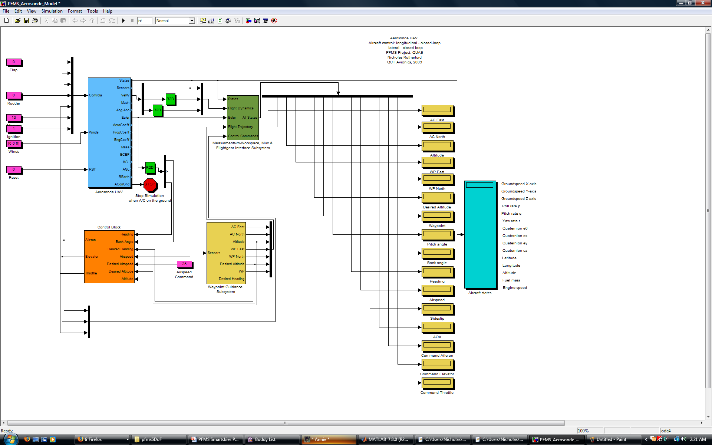
Simulink Implementation

Slide 16
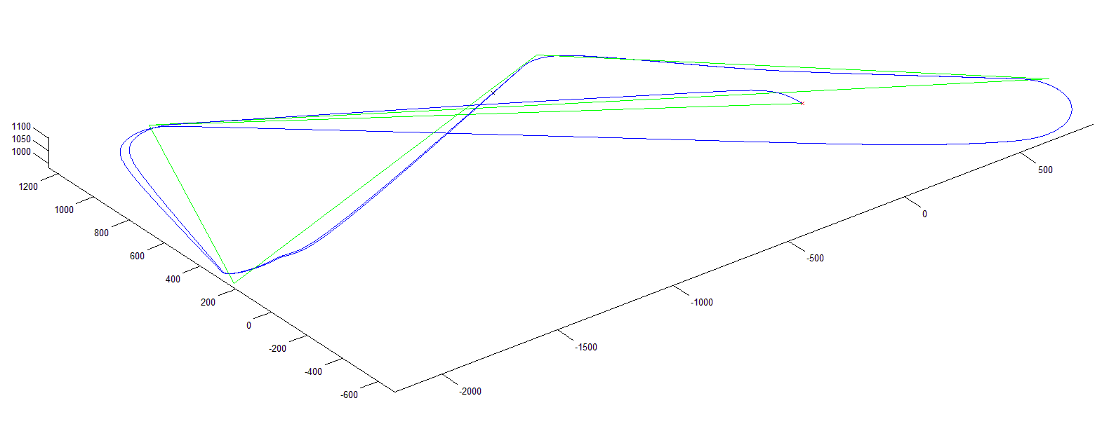
Flight Trajectory

Slide 17
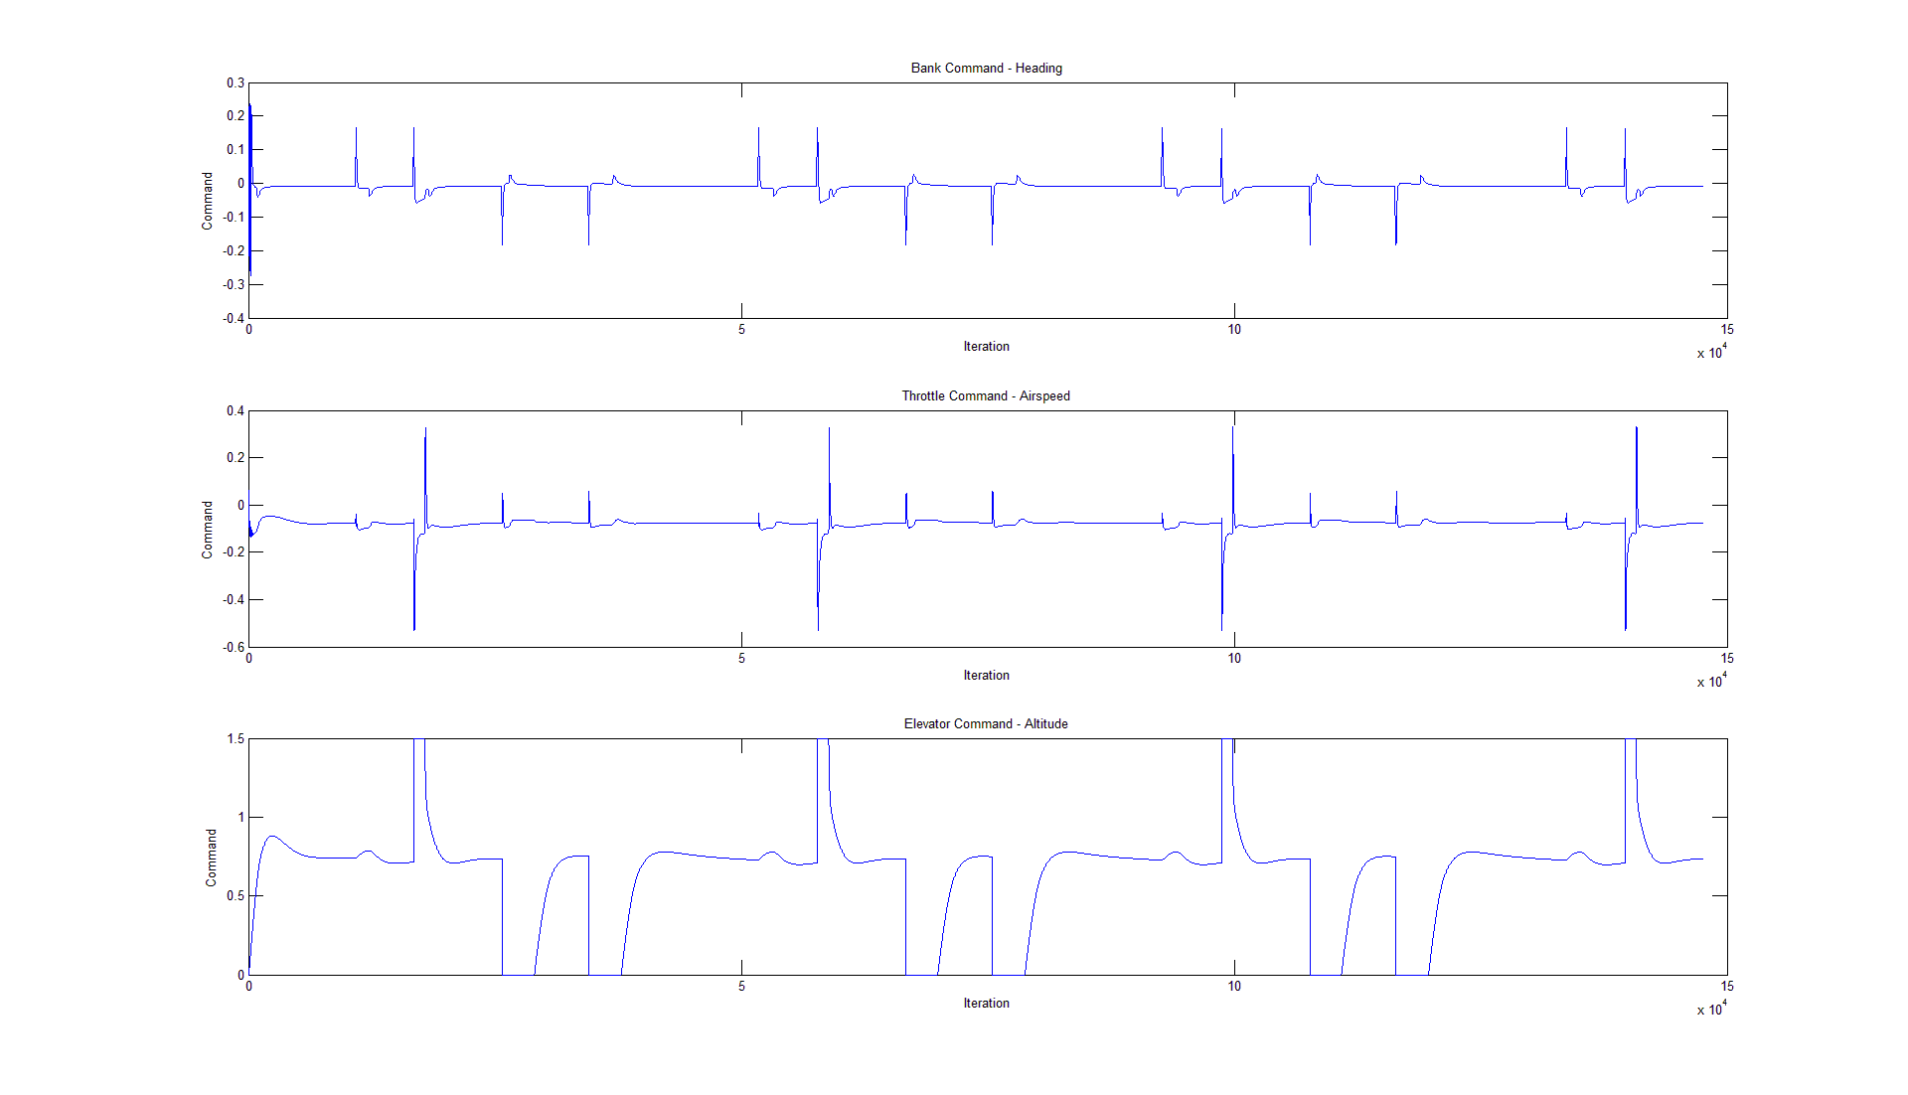
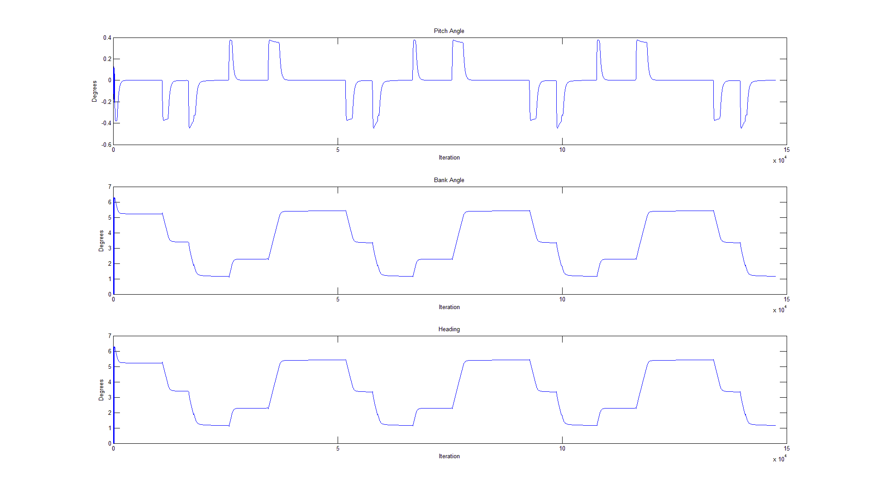
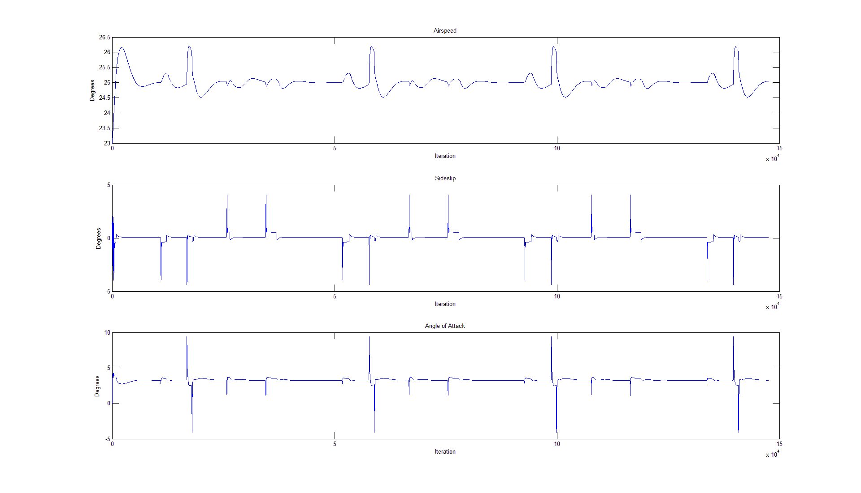
System Logs

Slide 18
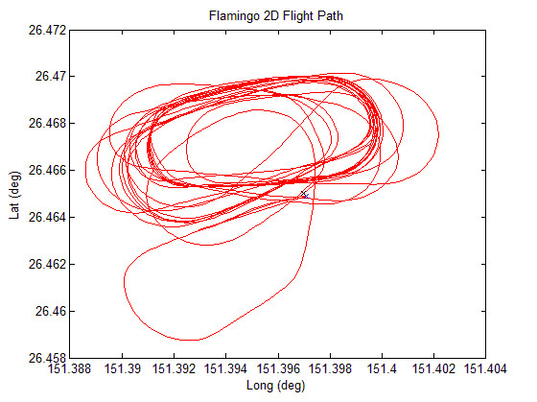
System Validation
Not official testing conditions.
Future controlled tests already planned.
Capture and compare standard telemetry.

Slide 19
Project Future and Final Notes
Final Key Points of interest
Processing capability.
Other PFMS applications.
Project future
Implementation onboard a UAS and testing and validation using standard telemetry.
Required implementation in C++.
Matlab Real Time Workshop for building Simulink Model.
Introduction of advanced concepts.

Slide 20
Conclusions
Predictive Flight Management System Concept
Systems Engineering Practices
High Level Objectives
Work Breakdown
Schedule
Project Risks and Budget
PFMS Models
Three Degree of Freedom Model
Six Degree of Freedom Model
Model Comparison and Validation
Project Future and Final Key Notes
Conclusion

Slide 21
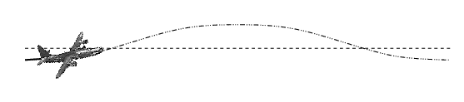
Issues
mention window of control
Modify Wind

